Slide 1
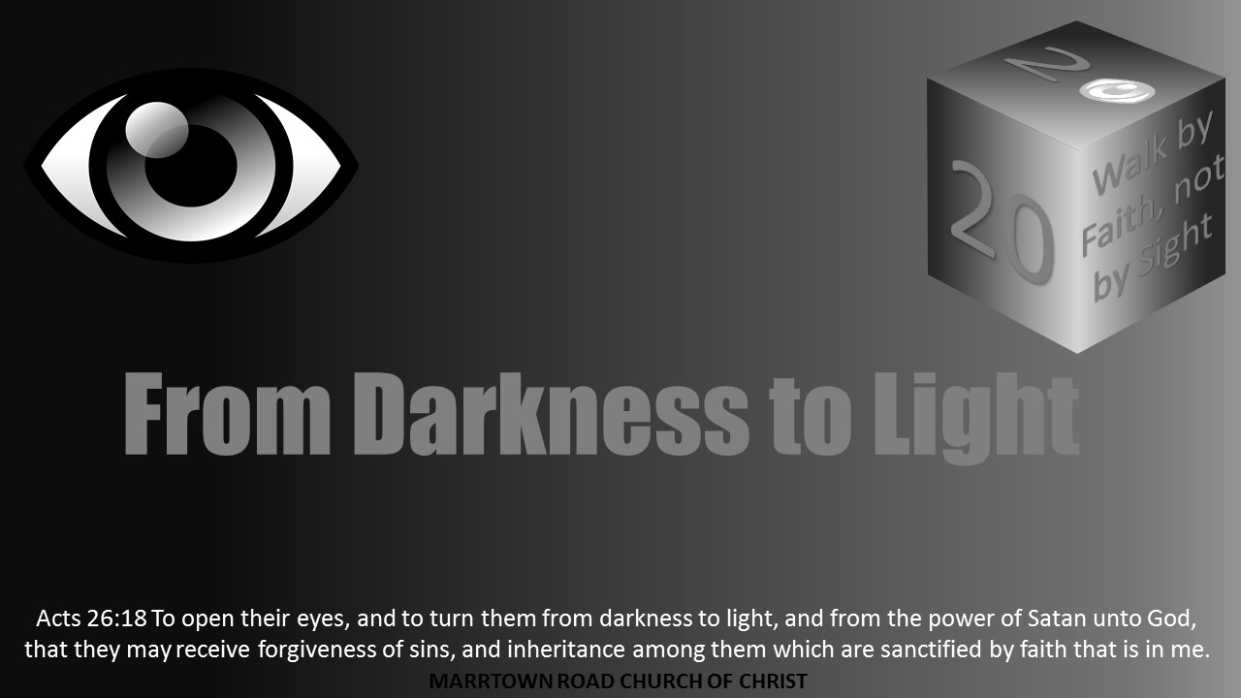


Slide 2
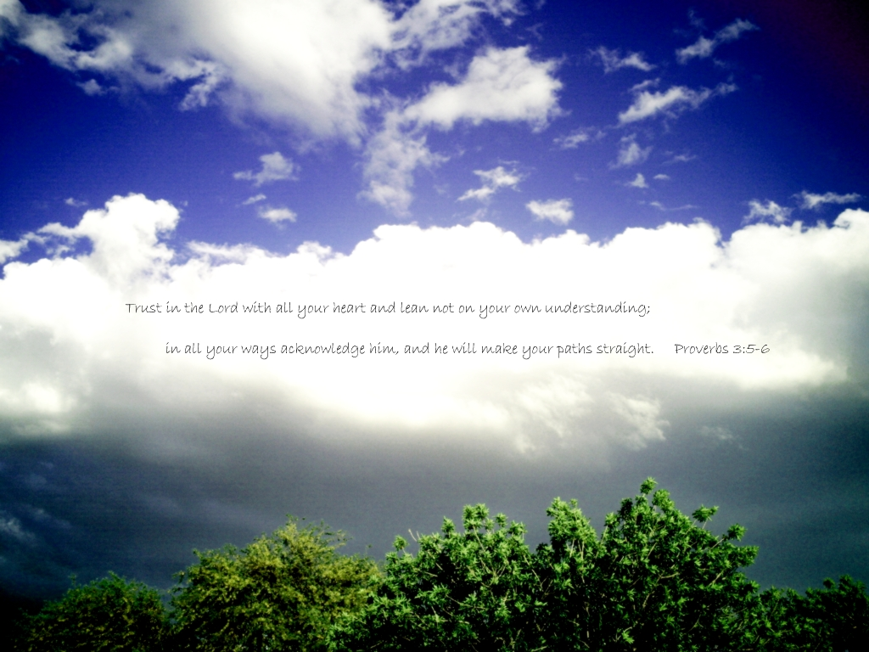
Spiritual Blind Spots

Slide 3
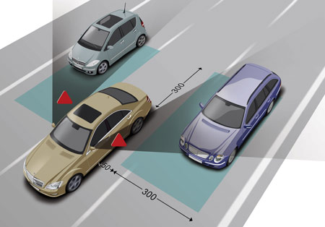
What Is a Blind Spot?
We all have physical blind spots in our vision which is typically 15 degrees from our central vision
We often talk about blind spots in a different way
It is “an area or subject about which is uninformed, prejudiced, or unappreciative” – dictionary.com
Is there such a thing as a spiritual blind spot?
Notes:
If we don’t accept the wisdom of God
Are we questioning is all knowing power?
Are we questioning his justice?
We don’t understand why … does that change it?

Slide 4
Spiritual Blind Spot - Uninformed
New convert or babe in Christ (I Peter 2:2)
Some choose to remain this way at their peril (I Cor. 3:2)
Solomon warns of the danger of remaining this way (Pr. 5:23)
The Bereans knew what Paul taught was true because they studied (Acts 17:11)
There are many warnings in scripture about false teachers (Gal. 1:6; Matt. 7:15; Acts 20:28-31)
How will we know the difference between righteous and sin unless we know God’s will? (II Tim. 2:15)
Notes:
If we don’t accept the wisdom of God
Are we questioning is all knowing power?
Are we questioning his justice?
We don’t understand why … does that change it?

Slide 5
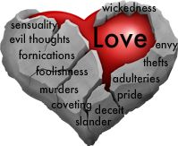
Spiritual Blind Spot - Prejudiced
We often have a view of things more influenced by the world than by the word of God
Differentiate on economic status (James 2:1-13)
Treat people differently because of their background (Gal. 2:11-21)
We say we love God but hate men (I Jn. 4:20,21)
All deserve to hear the gospel of Christ (Matt. 28:19)
All Christians are heirs according to the promise (Gal. 3:26-28)
Notes:
If we don’t accept the wisdom of God
Are we questioning is all knowing power?
Are we questioning his justice?
We don’t understand why … does that change it?

Slide 6
Spiritual Blind Spot - Unappreciative
We have scripture which is inspired of God (II Tim. 3:15,16; Pr. 5:23)
We have everything we need for life & godliness (II Pet. 1:3)
Those who instruct us in righteous living (Pr. 5:12, 13)
Satan wants us to sin (I Pet. 5:8; Jam. 1:13-15)
The danger of getting close to sin (Pr. 5:3-8; Pr. 22:3; I Cor. 15:33;)
Those who love us enough to warn and correct us (Heb. 12:5-11)
Notes:
If we don’t accept the wisdom of God
Are we questioning is all knowing power?
Are we questioning his justice?
We don’t understand why … does that change it?

